Slide 1

L2 Introduction to Machine Learning
Zonghua Gu, Umeå University
Nov. 2023

Slide 2
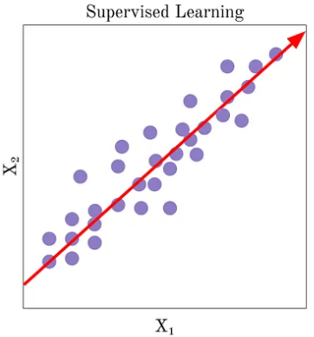
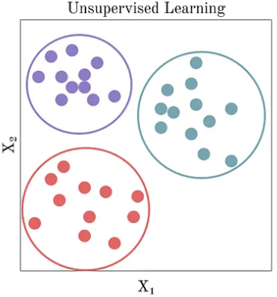
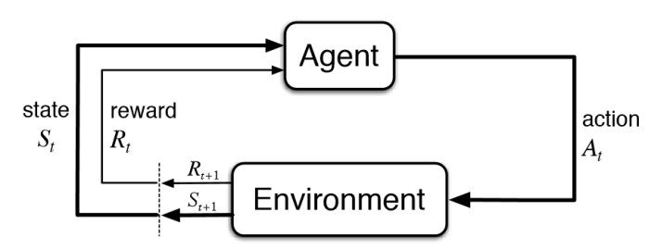
ML Taxonomy
Supervised Learning:
The system is presented with example inputs and their desired outputs, given by a “teacher”, and the goal is to learn a general rule that maps inputs to outputs
Classification (cat or dog?)
Regression (housing price next year?)
Unsupervised Learning:
No labels are given to the learning algorithm, leaving it on its own to find structure in its input. Unsupervised learning can be a goal in itself (discovering hidden patterns in data) or a means towards an end (feature learning)
Reinforcement Learning:
An agent interacts with a dynamic environment in which it must perform a certain goal. The agent is provided feedback in terms of rewards and it tries to learn an optimal policy that maximizes its cumulative rewards.
Applications: Game playing (AlphaGo); Robotics; AD…
Reinforcement Learning
Notes:
Algorithms: Model-based; Model-free (Value-based, Policy-based)
https://towardsdatascience.com/a-brief-introduction-to-unsupervised-learning-20db46445283

Slide 3
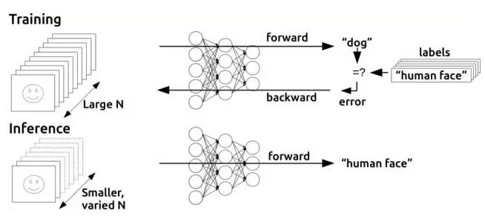
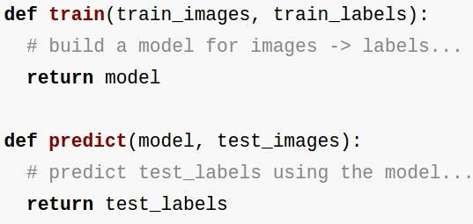
Training vs. Inference
Training: millions of iterations of forward pass + back propagation to adjust model params (e.g., NN weights); requires large CPU/GPU clusters and days/weeks of training time
Inference (also called prediction): a single forward pass; can be run on edge devices

Slide 4
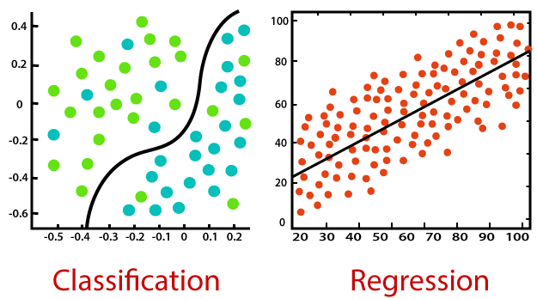
Supervised Learning: Classification and Regression
Both are Supervised Learning algorithms that require ground-truth values as labels.
Classification is used to predict/classify discrete labels such as Male or Female, True or False, Spam or Not Spam, etc.
Regression is used to predict continuous values such as price, salary, age, etc.
Loss functions measure how the predicted value differs from ground-truth value.
https://www.javatpoint.com/regression-vs-classification-in-machine-learning

Slide 5
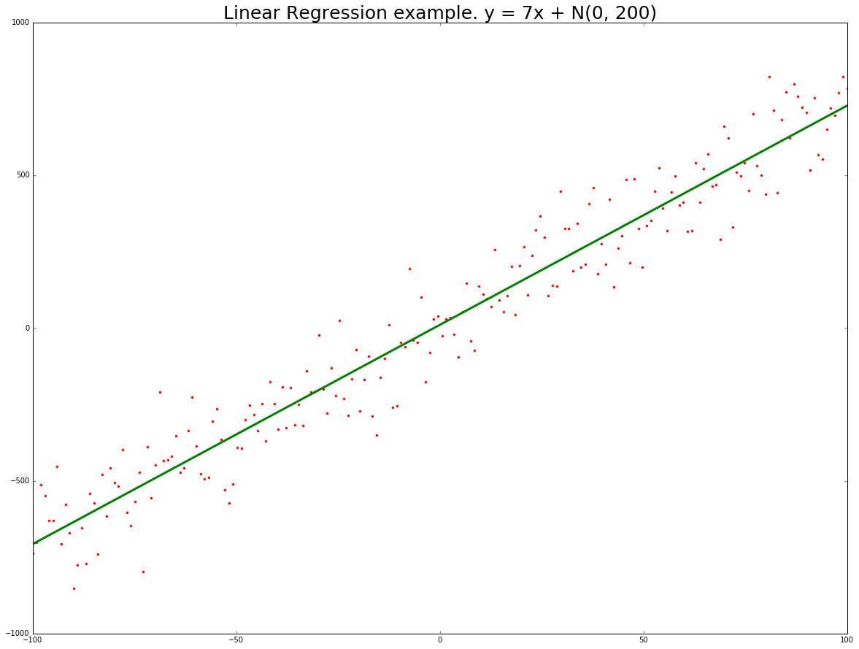
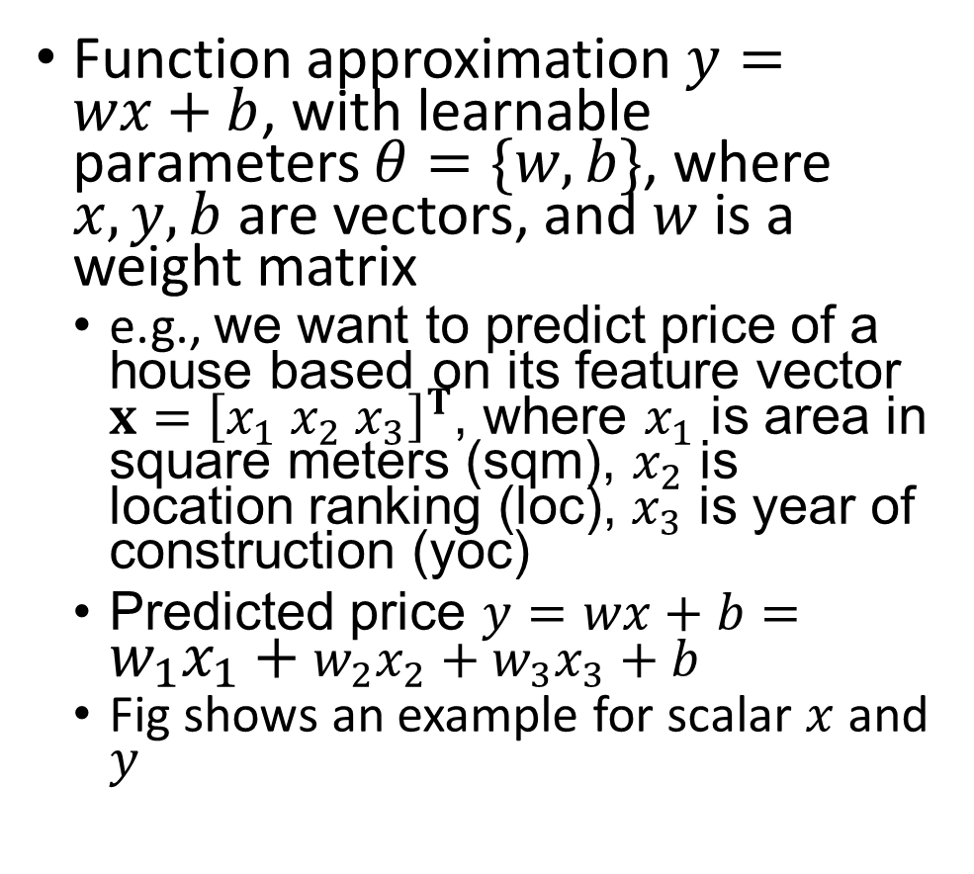
Linear Regression
Function approximation $y=wx+b$, with learnable parameters $θ=\{w,b\}$, where $x,y,b$ are vectors, and $w$ is a weight matrix
e.g., we want to predict price of a house based on its feature vector $x={\left[x_{1} x_{2} x_{3}\right]}^{T}$, where $x_{1}$ is area in square meters (sqm), $x_{2}$ is location ranking (loc), $x_{3}$ is year of construction (yoc)
Predicted price $y=wx+b=w_{1}x_{1}+w_{2}x_{2}+w_{3}x_{3}+b$
Fig shows an example for scalar $x$ and $y$

Slide 6
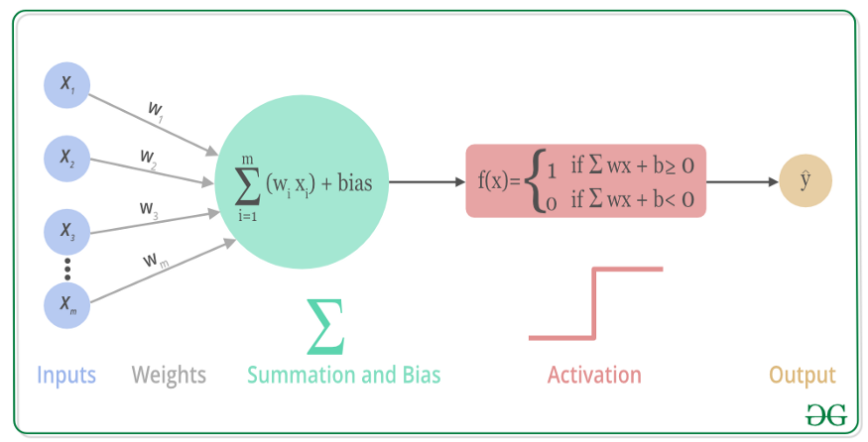
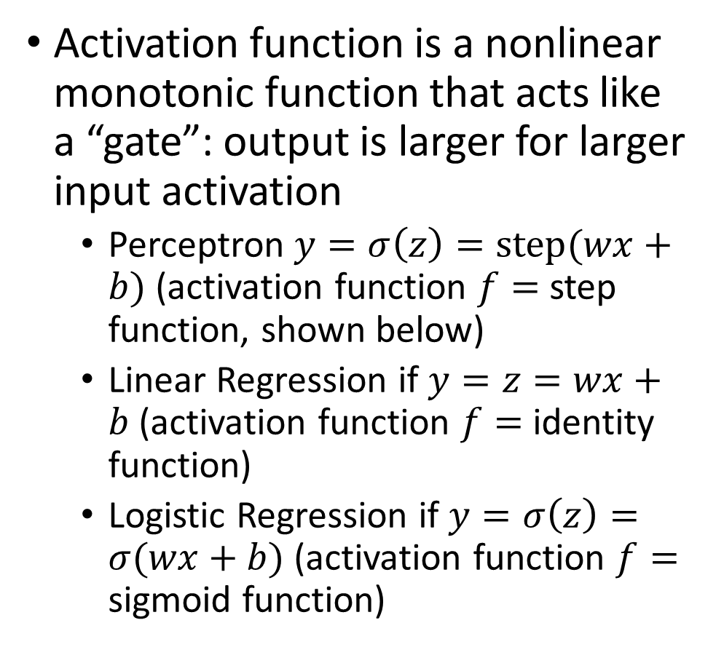
A Neuron and its Activation Function
Activation function is a nonlinear monotonic function that acts like a “gate”: output is larger for larger input activation
Perceptron $y=σ\left(z\right)=step(wx+b)$ (activation function $f=$ step function, shown below)
Linear Regression if $y=z=wx+b$ (activation function $f=$ identity function)
Logistic Regression if $y=σ\left(z\right)=σ(wx+b)$ (activation function $f=$ sigmoid function)

Slide 7
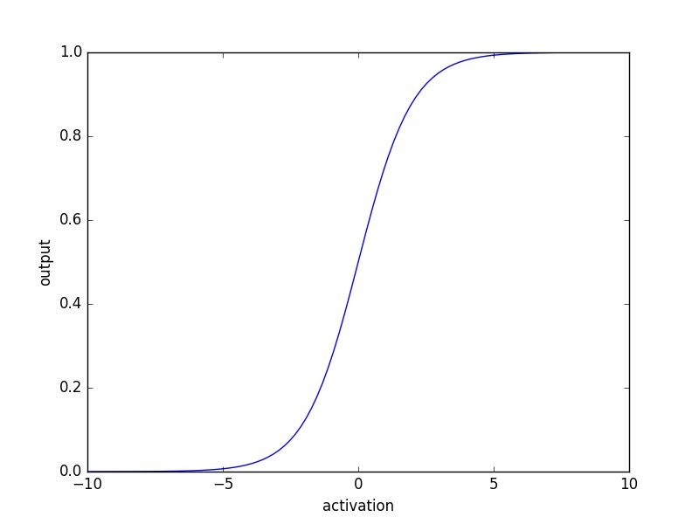
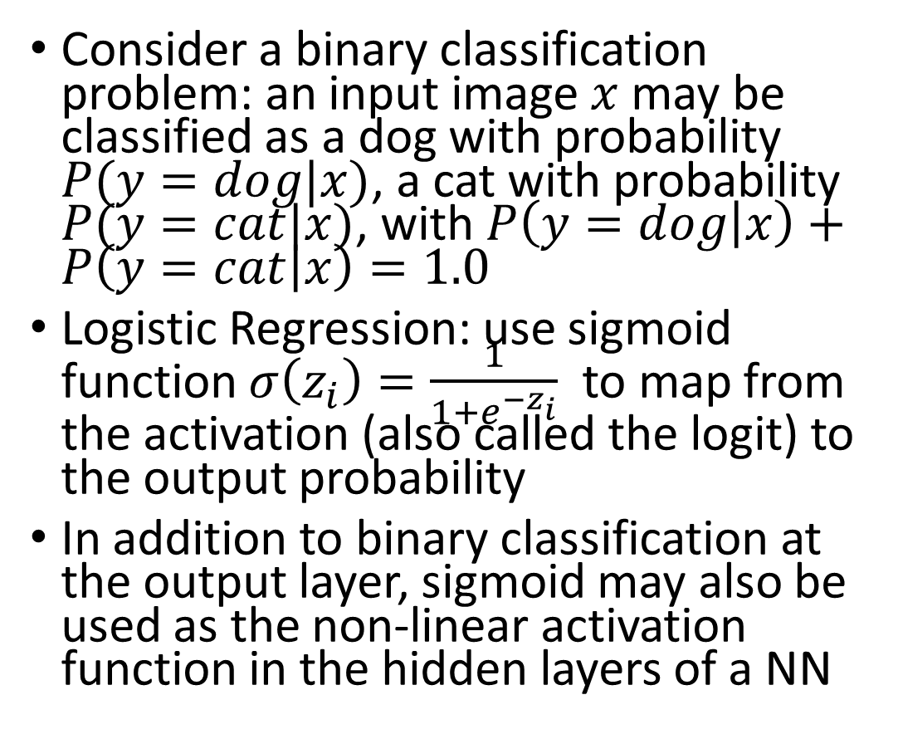
Logistic Regression for Binary Classification
Consider a binary classification problem: an input image $x$ may be classified as a dog with probability $P(y=dog|x)$, a cat with probability $P(y=cat|x)$, with $P\left(y=dog | x\right)+P\left(y=cat | x\right)=1.0$
Logistic Regression: use sigmoid function $σ\left(z_{i}\right)=\frac{1}{1+e^{−z_{i}}}$ to map from the activation (also called the logit) to the output probability
In addition to binary classification at the output layer, sigmoid may also be used as the non-linear activation function in the hidden layers of a NN
Sigmoid function

Slide 8
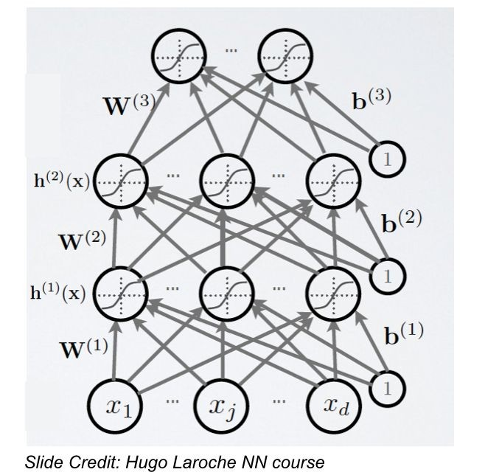
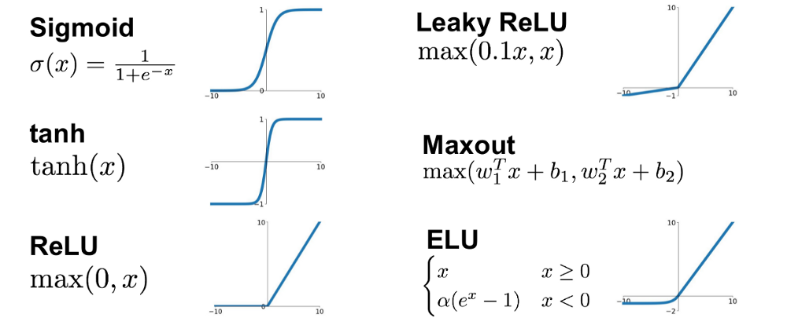
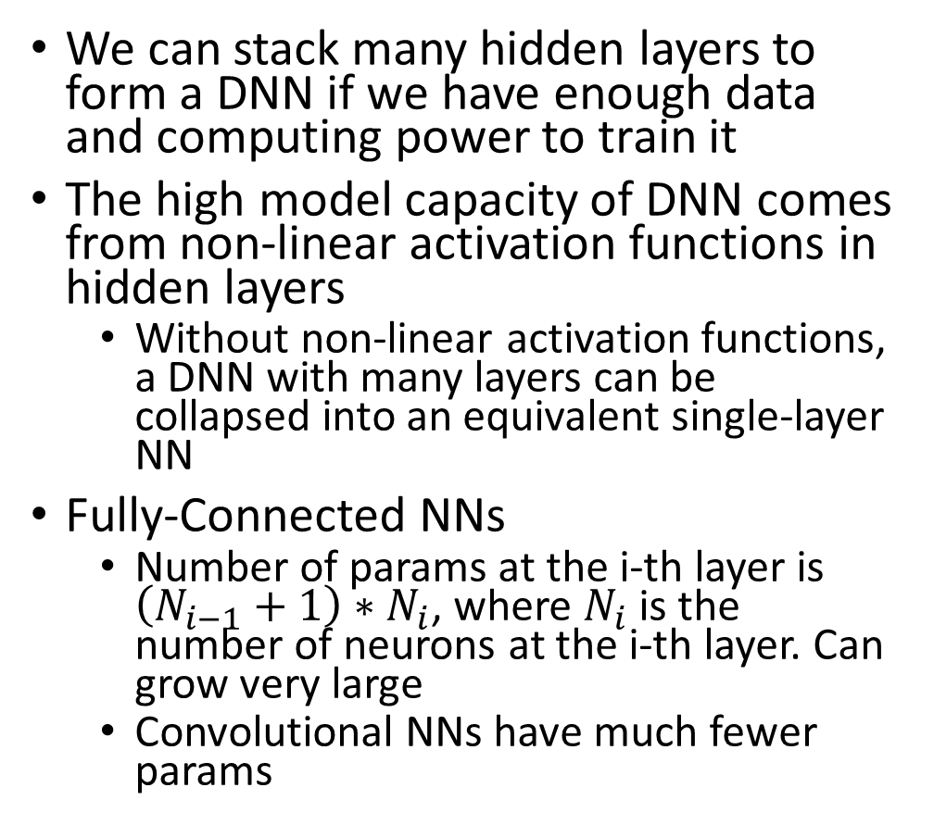
Deep Neural Networks and Activation Functions
We can stack many hidden layers to form a DNN if we have enough data and computing power to train it
The high model capacity of DNN comes from non-linear activation functions in hidden layers
Without non-linear activation functions, a DNN with many layers can be collapsed into an equivalent single-layer NN
Fully-Connected NNs
Number of params at the i-th layer is $\left(N_{i−1}+1\right)∗N_{i}$, where $N_{i}$ is the number of neurons at the i-th layer. Can grow very large
Convolutional NNs have much fewer params
Common Activation Functions
https://laptrinhx.com/complete-guide-of-activation-functions-574622854/

Slide 9
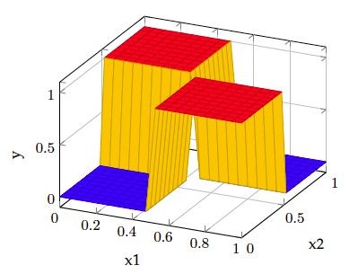
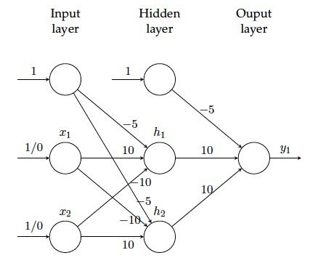
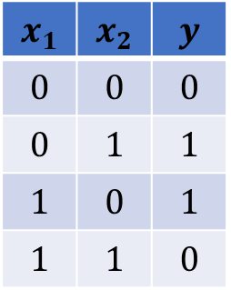
Example: Two-Layer Fully-Connected NN for Solving XOR
Consists of one input, one hidden, and one output layer, with sigmoid activations
$$x_{1}$$ | $$x_{2}$$ | $$y$$
$$0$$ | $$0$$ | $$0$$
$$0$$ | $$1$$ | $$1$$
$$1$$ | $$0$$ | $$1$$
$$1$$ | $$1$$ | $$0$$

Slide 10
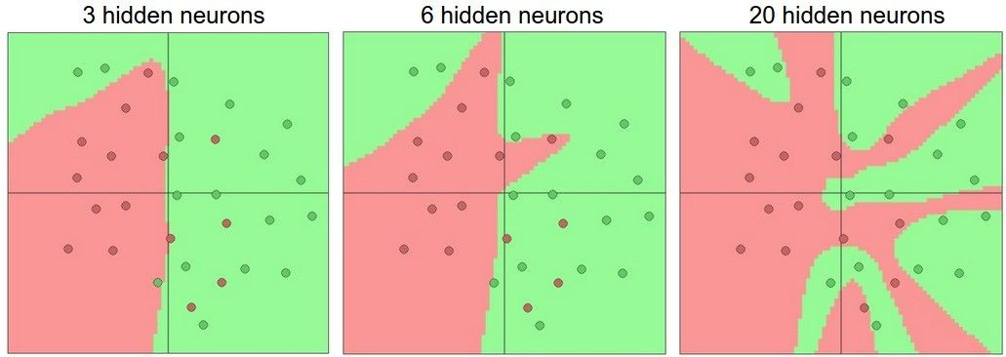
Setting # Layers and Their Sizes
An example illustrating adding more hidden neurons increases model capacity and reduces training error
But too many layers and neurons may lead to overfitting

Slide 11
Loss Functions
Classification
Cross-Entropy Loss, Log Loss, Focal Loss, Exponential Loss, Hinge Loss…
Regression
MSE (Mean Squared Error)/L2 Loss/Quadratic Loss, MAE (Mean Absolute Error)/L1 Loss, Huber Loss, Log Cosh Loss, Quantile Loss…

Slide 12
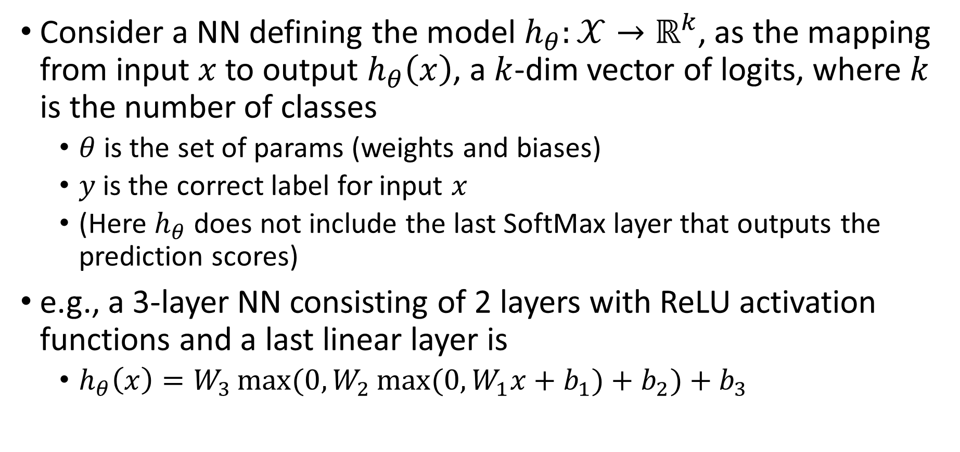
NN for Multi-Class Classification
Consider a NN defining the model $h_{θ}:𝒳→ℝ^{k}$, as the mapping from input $x$ to output $h_{θ}\left(x\right)$, a $k$-dim vector of logits, where $k$ is the number of classes
$θ$ is the set of params (weights and biases)
$y$is the correct label for input $x$
(Here $h_{θ}$ does not include the last SoftMax layer that outputs the prediction scores)
e.g., a 3-layer NN consisting of 2 layers with ReLU activation functions and a last linear layer is
$h_{θ}\left(x\right)=W_{3}\max{(0,W_{2}\max{(0,W_{1}x+b_{1})}+b_{2})}+b_{3}$

Slide 13
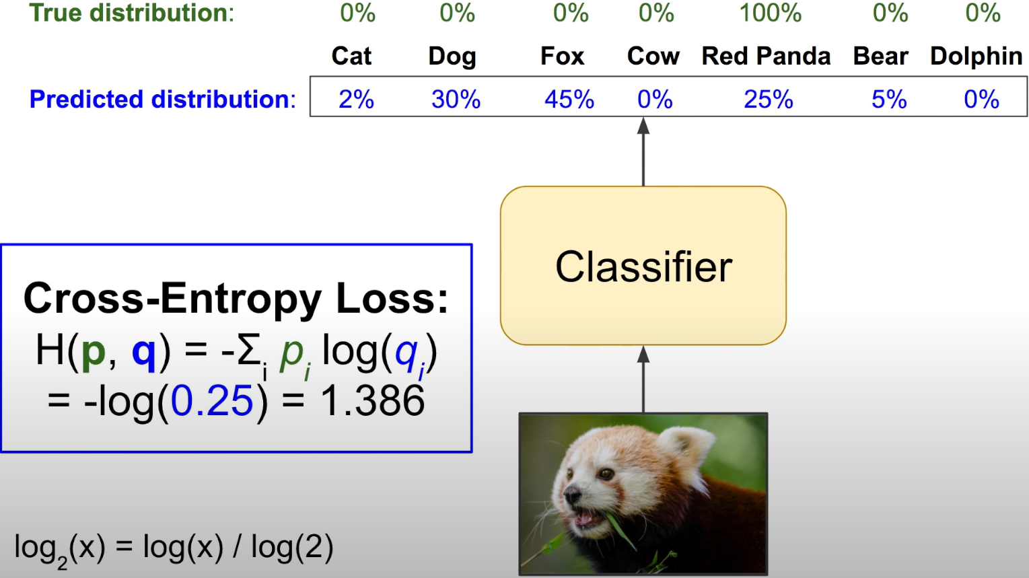
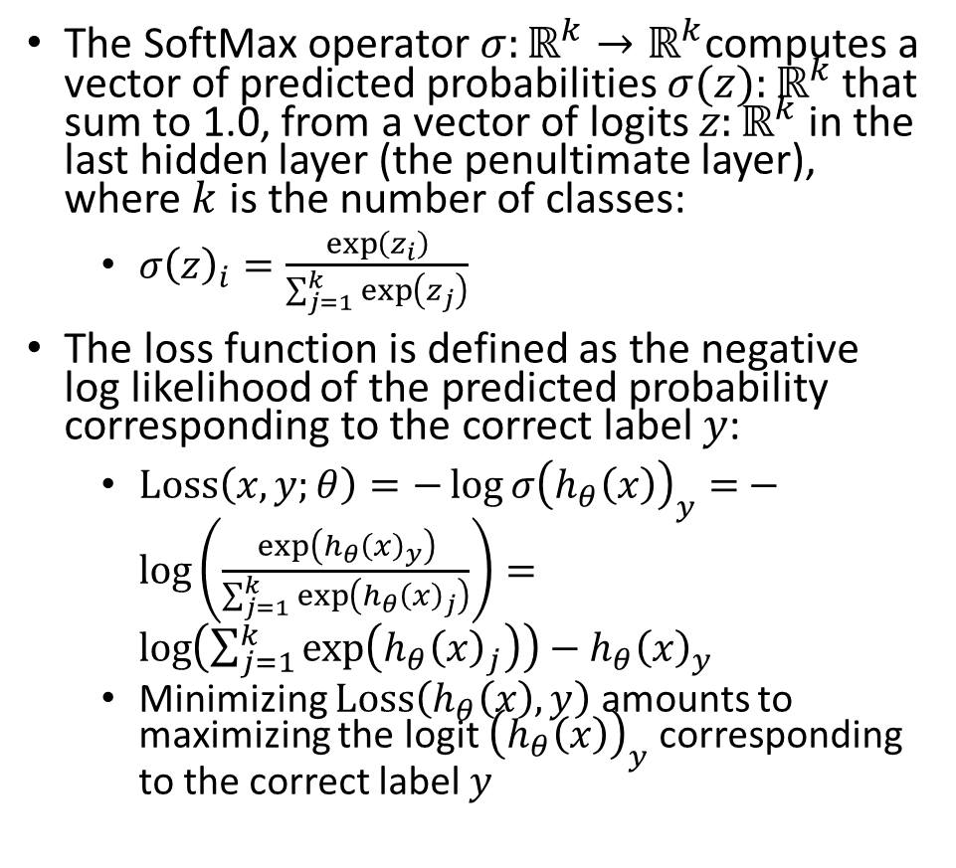
Cross-Entropy Loss for Multi-Class Classification
Important
The SoftMax operator $σ:ℝ^{k}→ℝ^{k}$computes a vector of predicted probabilities $σ(z):ℝ^{k}$ that sum to 1.0, from a vector of logits $z:ℝ^{k}$ in the last hidden layer (the penultimate layer), where $k$ is the number of classes:
$σ{\left(z\right)}_{i}=\frac{\exp\left(z_{i}\right)}{\sum_{j=1}^{k}{\exp\left(z_{j}\right)}}$
The loss function is defined as the negative log likelihood of the predicted probability corresponding to the correct label $y$:
$Loss\left(x,y;θ\right)=−\log{σ{\left(h_{θ}\left(x\right)\right)}_{y}=}−\log\left(\frac{\exp\left(h_{θ}{\left(x\right)}_{y}\right)}{\sum_{j=1}^{k}{\exp\left(h_{θ}{\left(x\right)}_{j}\right)}}\right)=\log\left(\sum_{j=1}^{k}{\exp\left(h_{θ}{\left(x\right)}_{j}\right)}\right)−h_{θ}{\left(x\right)}_{y}$
Minimizing $Loss\left(h_{θ}\left(x\right),y\right)$ amounts to maximizing the logit ${\left(h_{θ}\left(x\right)\right)}_{y}$ corresponding to the correct label $y$
Aurélien Géron A Short Introduction to Entropy, Cross-Entropy and KL-Divergence (YouTube)

Slide 14
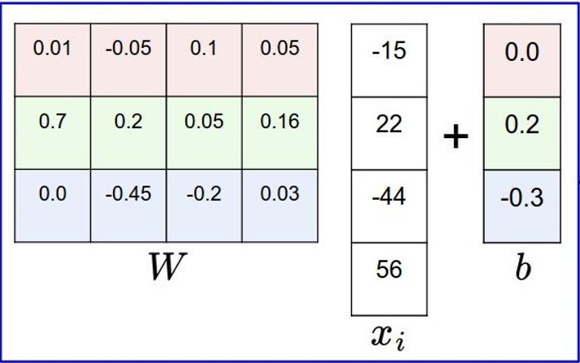
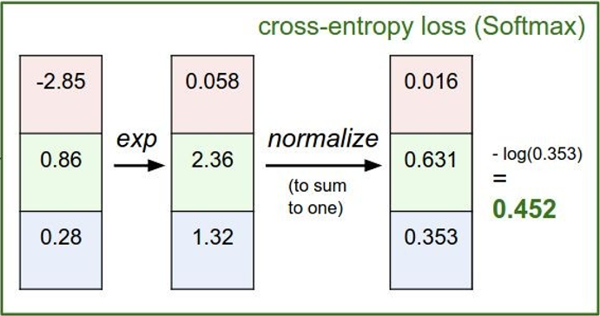
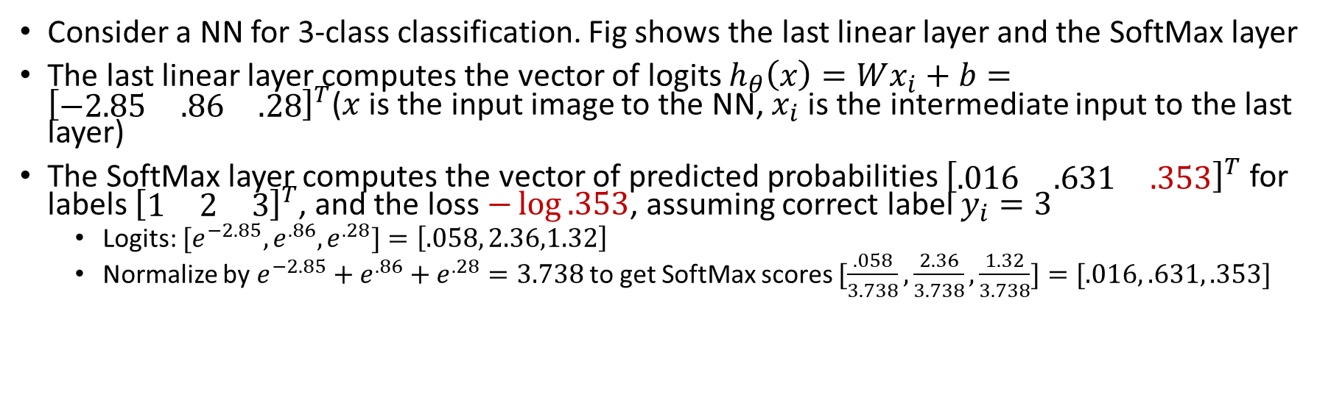
CE Loss Example
Consider a NN for 3-class classification. Fig shows the last linear layer and the SoftMax layer
The last linear layer computes the vector of logits $h_{θ}\left(x\right)=Wx_{i}+b={\left[\begin{matrix}−2.85 & .86 & .28\end{matrix}\right]}^{T}$($x$ is the input image to the NN, $x_{i}$ is the intermediate input to the last layer)
The SoftMax layer computes the vector of predicted probabilities ${\left[\begin{matrix}.016 & .631 & .353\end{matrix}\right]}^{T}$ for labels ${\left[\begin{matrix}1 & 2 & 3\end{matrix}\right]}^{T}$, and the loss $−\log{.353}$, assuming correct label $y_{i}=3$
Logits: ${[e}^{−2.85}, e^{.86},e^{.28}]=\left[.058, 2.36,1.32\right]$
Normalize by $e^{−2.85}+e^{.86}+e^{.28}=3.738$ to get SoftMax scores $[\frac{.058}{3.738},\frac{2.36}{3.738},\frac{1.32}{3.738}]=[.016, .631, .353]$
correct
label
Last Linear Layer
SoftMax Layer

Slide 15
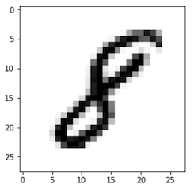

Multi-Class Image Classification
Two stages: feature extraction from input, and classification based on extracted features
Classifier returns output as a list of probabilities with size equal to the number of classes, but it may also return the top-1 or top-5 results with highest probability ranking
$$P\left(0\right)=.01$$
$$P\left(1\right)=.01$$
$$P\left(2\right)=.01$$
$$P\left(3\right)=.02$$
$$P\left(4\right)=.03$$
$$P\left(5\right)=.01$$
$$P\left(6\right)=.02$$
$$P\left(7\right)=.02$$
$$P\left(8\right)=.85$$
$$P\left(9\right)=.02$$
Feature
Extraction
Classifier
sum
to 1.0
CNN
(or classic CV algo)
SoftMax

Slide 16
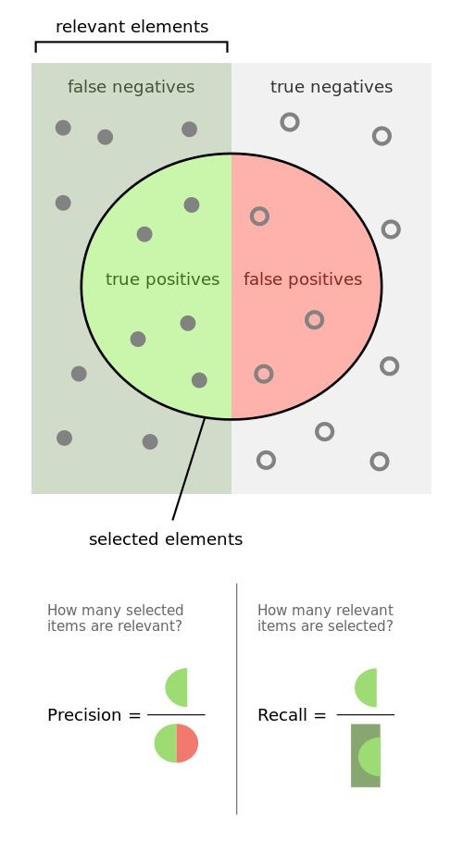

Binary Classification Metrics
The relevant class is considered “Positive” in a binary classifier
e.g., conswider a medical test that aims to diagnose people with a certain disease. “Positive” denotes sick (has disease), and “Negative” denotes healthy (no disease)
True Positive (TP): a sick person is diagnosed as sick
True Negative (TN): a healthy person is diagnosed as healthy
False Positive (FP): a healthy person is misdiagnosed as sick
False Negative (FN): a sick person is misdiagnosed as healthy
Never Forget Again! // Precision vs Recall with a Clear Example of Precision and Recall by Kimberly Fessel
https://www.youtube.com/watch?v=qWfzIYCvBqo
Precision = $\frac{TP}{TP+FP}$, Recall (TPR) = $\frac{TP}{TP+FN}$

Slide 17
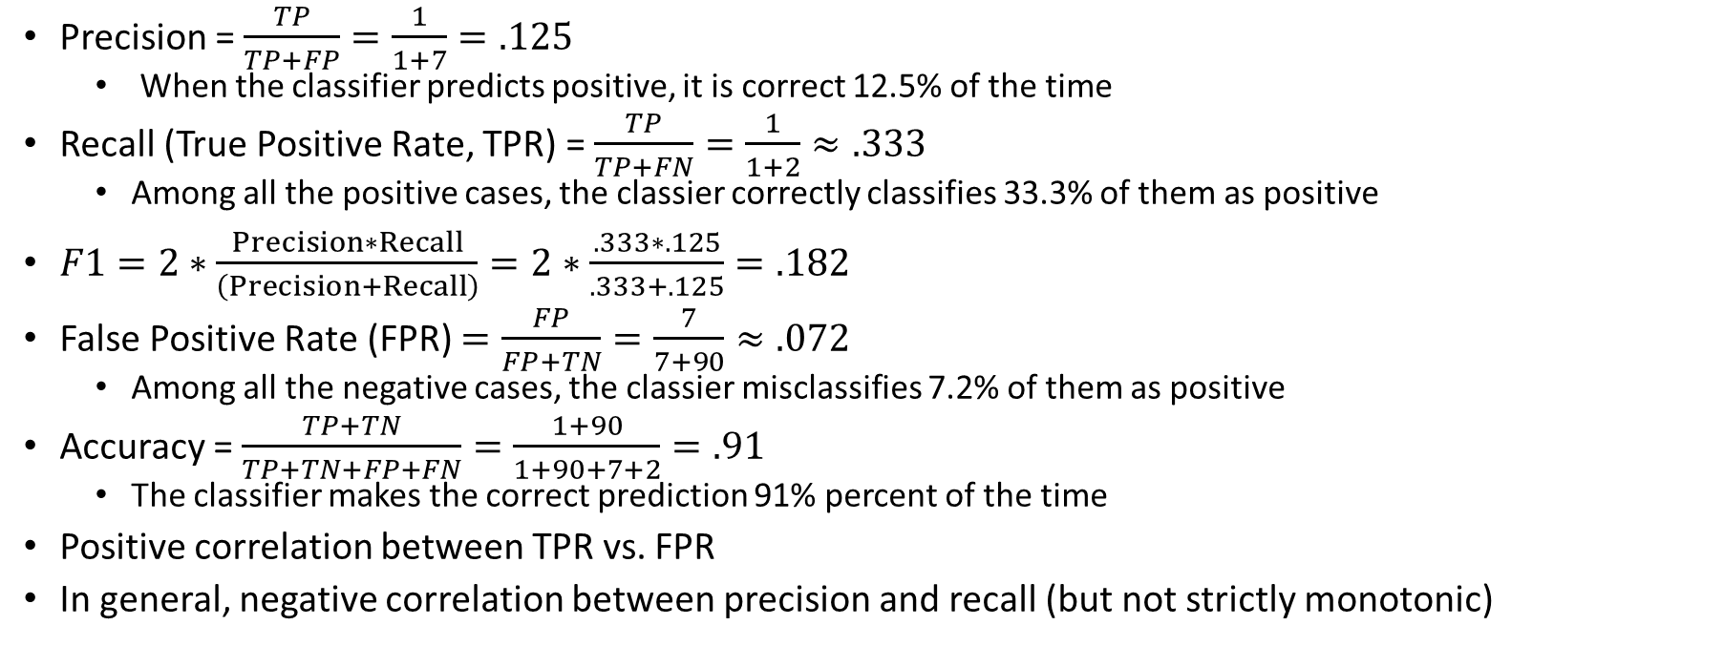
Example Confusion Matrix 1
Precision = $\frac{TP}{TP+FP}=\frac{1}{1+7}=.125$
When the classifier predicts positive, it is correct 12.5% of the time
Recall (True Positive Rate, TPR) = $\frac{TP}{TP+FN}=\frac{1}{1+2}≈.333$
Among all the positive cases, the classier correctly classifies 33.3% of them as positive
$F1=2∗\frac{Precision∗Recall}{\left(Precision+Recall\right)}=2∗\frac{.333∗.125}{.333+.125}=.182$
False Positive Rate (FPR) $=\frac{FP}{FP+TN}=\frac{7}{7+90}≈.072$
Among all the negative cases, the classier misclassifies 7.2% of them as positive
Accuracy = $\frac{TP+TN}{TP+TN+FP+FN}=\frac{1+90}{1+90+7+2}=.91$
The classifier makes the correct prediction 91% percent of the time
Positive correlation between TPR vs. FPR
In general, negative correlation between precision and recall (but not strictly monotonic)
 |  | Ground Truth
 |  | Positive | Negative
Predicted | Neg | False Negative (FN)=2 | True Negative (TN)=90
 | Pos | True Positive (TP)=1 | False Positive (FP)=7
https://medium.com/swlh/recall-precision-f1-roc-auc-and-everything-542aedf322b9

Slide 18
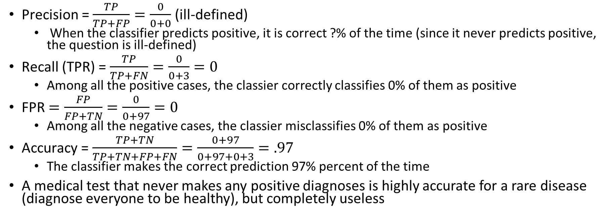
Example Confusion Matrix 2
Precision = $\frac{TP}{TP+FP}=\frac{0}{0+0}$ (ill-defined)
When the classifier predicts positive, it is correct ?% of the time (since it never predicts positive, the question is ill-defined)
Recall (TPR) = $\frac{TP}{TP+FN}=\frac{0}{0+3}=0$
Among all the positive cases, the classier correctly classifies 0% of them as positive
FPR $=\frac{FP}{FP+TN}=\frac{0}{0+97}=0$
Among all the negative cases, the classier misclassifies 0% of them as positive
Accuracy = $\frac{TP+TN}{TP+TN+FP+FN}=\frac{0+97}{0+97+0+3}=.97$
The classifier makes the correct prediction 97% percent of the time
A medical test that never makes any positive diagnoses is highly accurate for a rare disease (diagnose everyone to be healthy), but completely useless
 |  | Ground Truth
 |  | Positive | Negative
Predicted | Neg | False Negative (FN)=3 | True Negative (TN)=97
 | Pos | True Positive (TP)=0 | False Positive (FP)=0

Slide 19
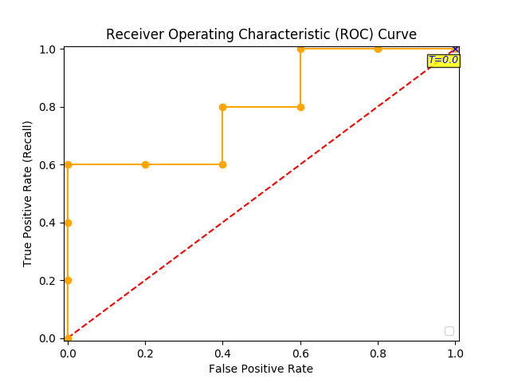
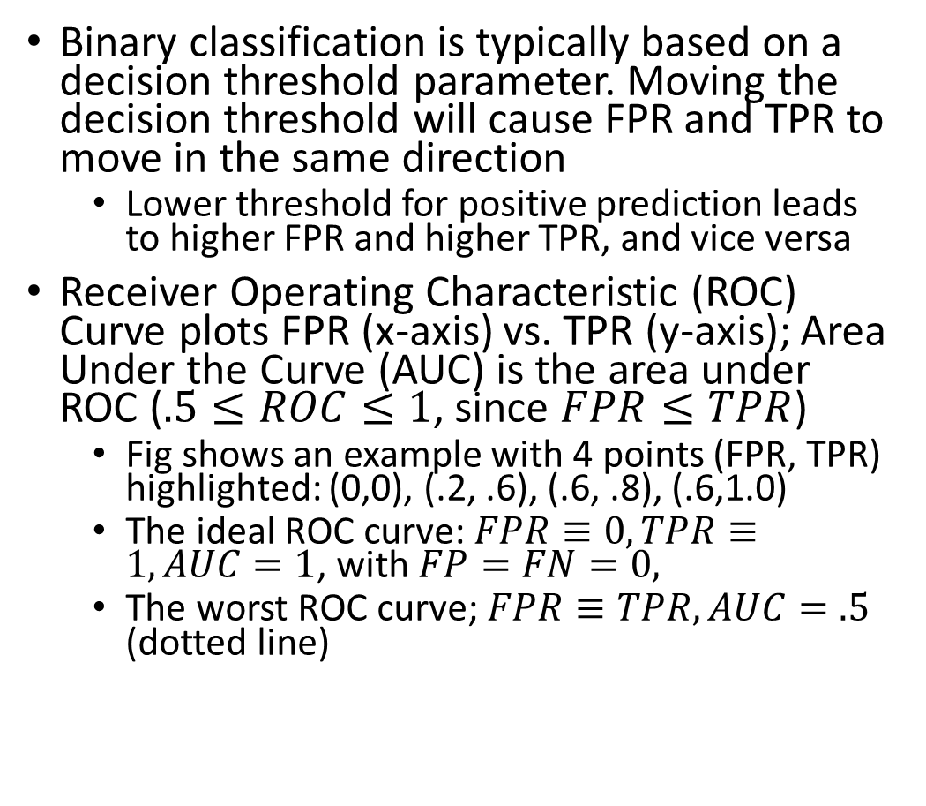
ROC and AUC
Binary classification is typically based on a decision threshold parameter. Moving the decision threshold will cause FPR and TPR to move in the same direction
Lower threshold for positive prediction leads to higher FPR and higher TPR, and vice versa
Receiver Operating Characteristic (ROC) Curve plots FPR (x-axis) vs. TPR (y-axis); Area Under the Curve (AUC) is the area under ROC ($.5≤ROC≤1$, since $FPR≤TPR$)
Fig shows an example with 4 points (FPR, TPR) highlighted: (0,0), (.2, .6), (.6, .8), (.6,1.0)
The ideal ROC curve: $FPR≡0,TPR≡1, AUC=1$, with $FP=FN=0,$
The worst ROC curve; $FPR≡TPR, AUC=.5$ (dotted line)
Decision
thresh.
Distribution of negative data items
Distribution of positive data items
TN
TP
FN
FP
Feature
Predict negative
Predict positive

Slide 20
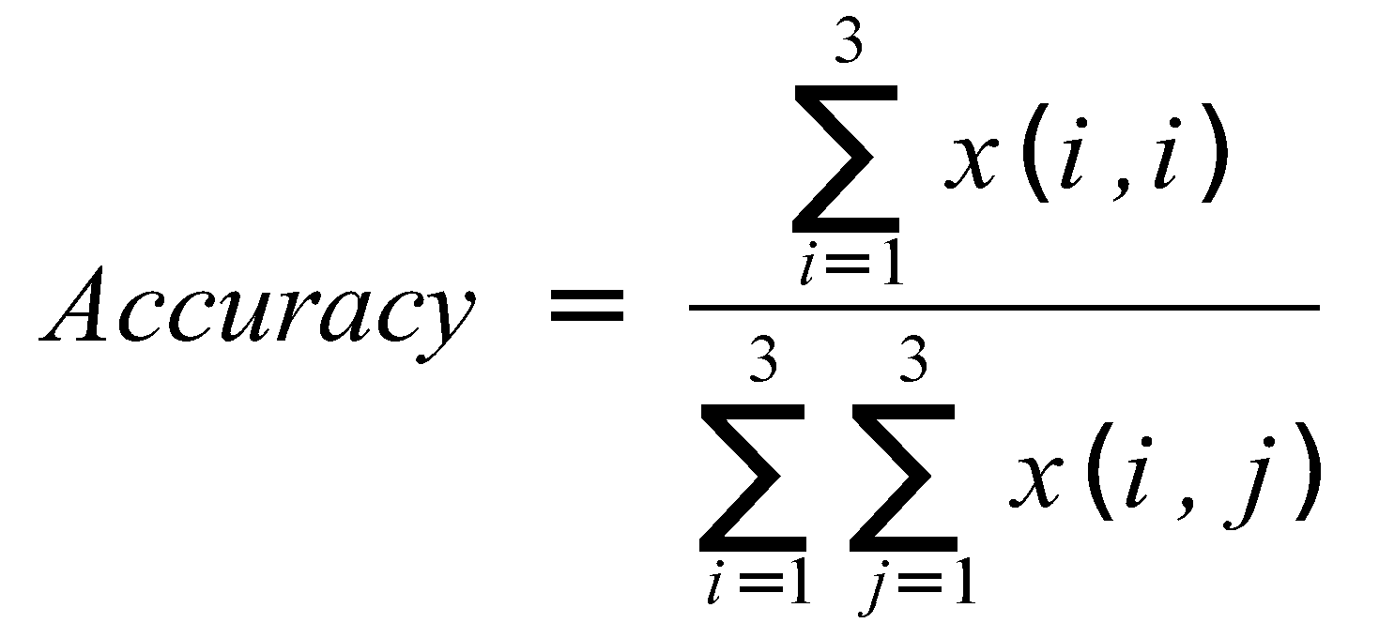
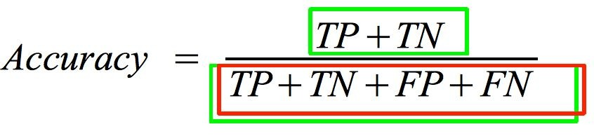
Confusion Matrix
Binary classification is a special case of multi-class classification
Binary
 |  | Ground Truth
 |  | Cls1 | Cls2 | Cls3
Pred. | Cls3
 | Cls2
 | Cls1
 |  | Ground Truth
 |  | Pos | Neg
Pred. | Pos | FN | TN
 | Neg | TP | FP

Slide 21

Training Neural Networks

Slide 22
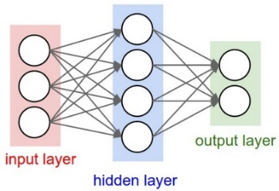

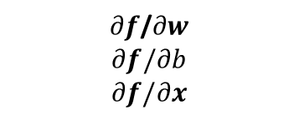


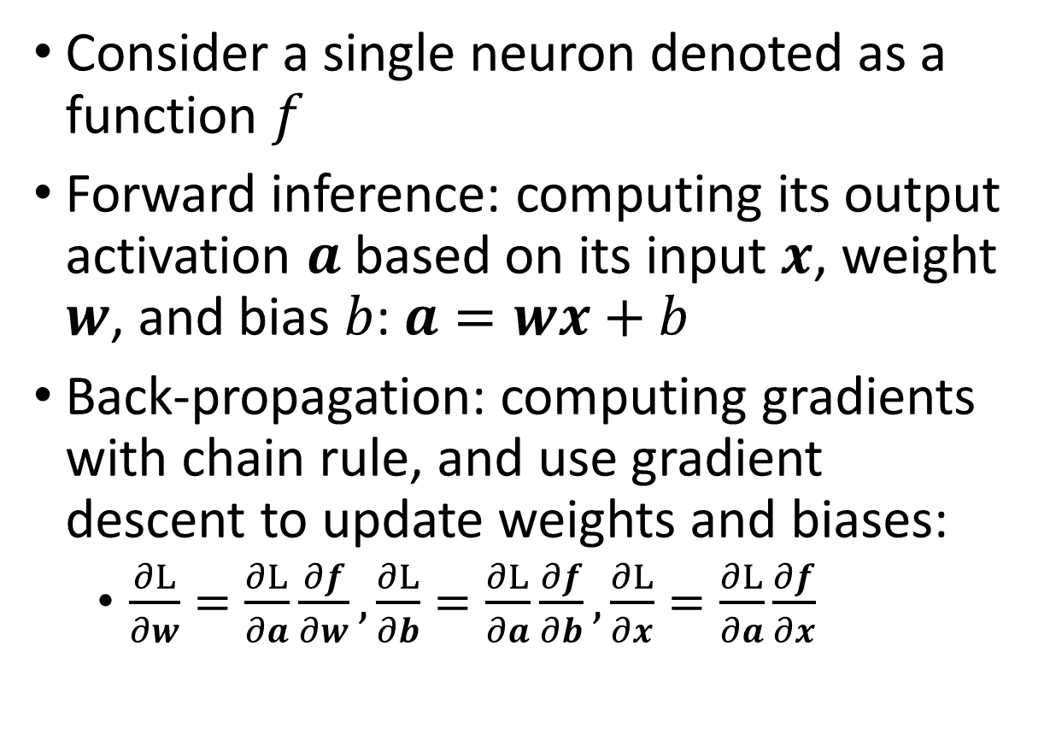





Back-Propagation for NN Training
Consider a single neuron denoted as a function $f$
Forward inference: computing its output activation $a$based on its input $x$, weight $w$, and bias $b$: $a=wx+b$
Back-propagation: computing gradients with chain rule, and use gradient descent to update weights and biases:
$\frac{∂L}{∂w}=\frac{∂L}{∂a}\frac{∂f}{∂w},\frac{∂L}{∂b}=\frac{∂L}{∂a}\frac{∂f}{∂b},\frac{∂L}{∂x}=\frac{∂L}{∂a}\frac{∂f}{∂x}$
$$w$$
activations
params
f
$$a$$
$$b$$
input
$$x$$
$$∂L/∂w$$
$∂f$/$∂w$
$$∂f/∂b$$
$$∂f/∂x$$
gradients
$$∂L/∂b$$
$$∂L/∂a$$
$$∂L/∂x$$
Forward inference (fast)
Gradient back-prop (slow)

Slide 23
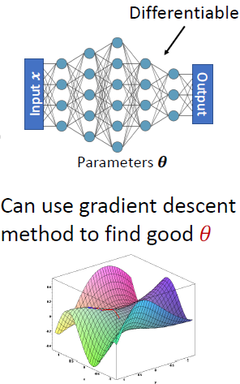
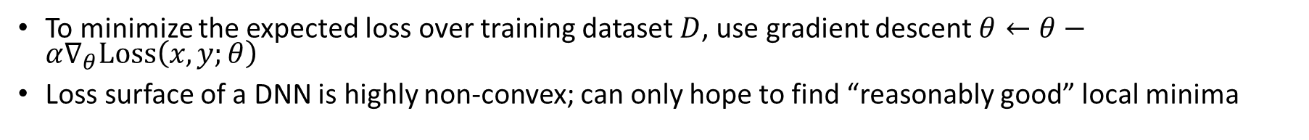

Gradient Descent
To minimize the expected loss over training dataset $D$, use gradient descent $θ←θ−α∇_{θ}Loss\left(x,y;θ\right)$
Loss surface of a DNN is highly non-convex; can only hope to find “reasonably good” local minima
$$𝔼_{\left(x,y\right)∼D}Loss(x,y;θ)$$

Slide 24
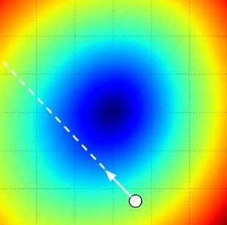
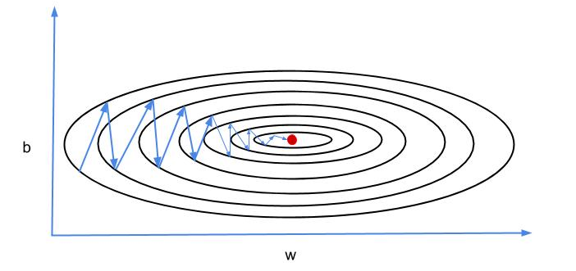



Gradient Descent
Steepest descent may result in inefficient zig-zag path
More advanced GD methods exploit momentum, e.g., Nesterov, AdaGrad, RMSProp, Adam…
Mini-batch Stochastic Gradient Descent
Only use a small portion (a mini-batch) of the training data to compute the gradient
Common mini-batch sizes are 32/64/128 examples
Loop:
Sample a mini-batch of data
Forward prop it through the graph, get loss
Backprop to calculate the gradients
Update the parameters using gradient descent
$$θ_{2}$$
$$θ$$
Negative gradient direction
$$θ_{1}$$
http://dataplusplus.ca/blog/2017/gradient-descent-with-momentum

Slide 25
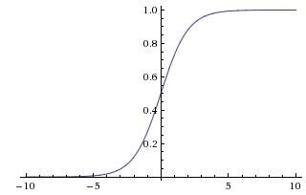
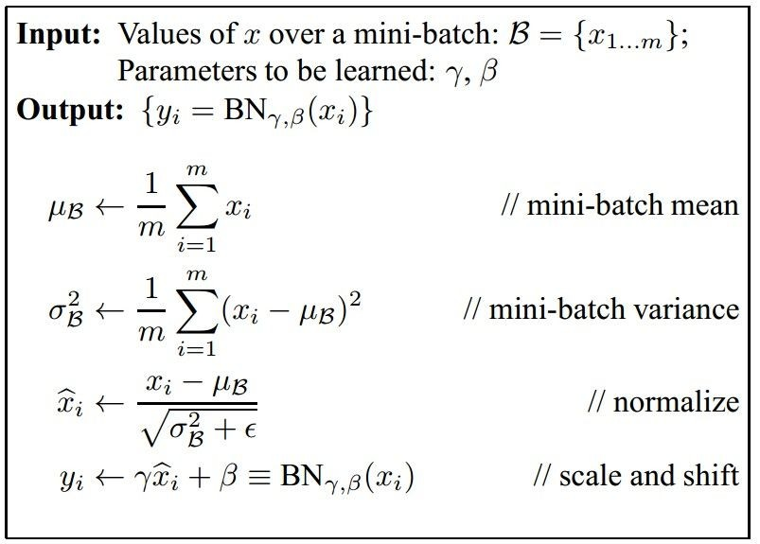
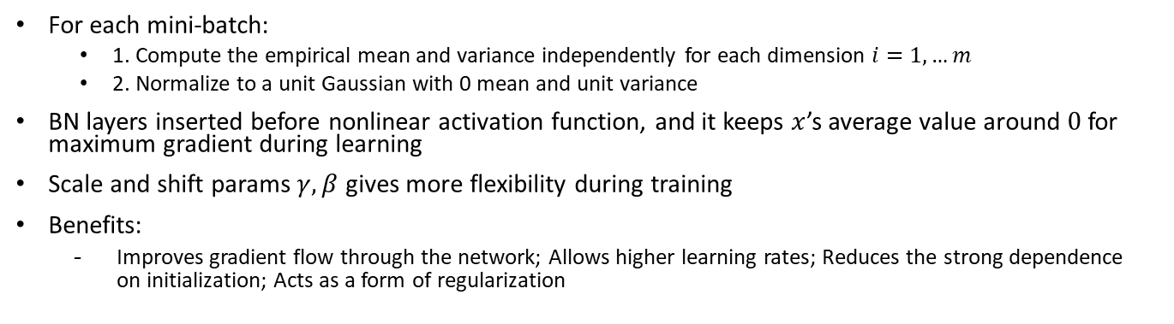
Batch Normalization
For each mini-batch:
1. Compute the empirical mean and variance independently for each dimension $i=1,…m$
2. Normalize to a unit Gaussian with 0 mean and unit variance
BN layers inserted before nonlinear activation function, and it keeps $x$’s average value around $0$ for maximum gradient during learning
Scale and shift params $γ,β$ gives more flexibility during training
Benefits:
Improves gradient flow through the network; Allows higher learning rates; Reduces the strong dependence on initialization; Acts as a form of regularization
CONV
BN
tanh
FC
BN
tanh
...

Slide 26
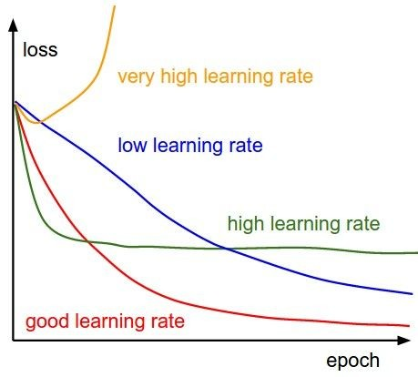
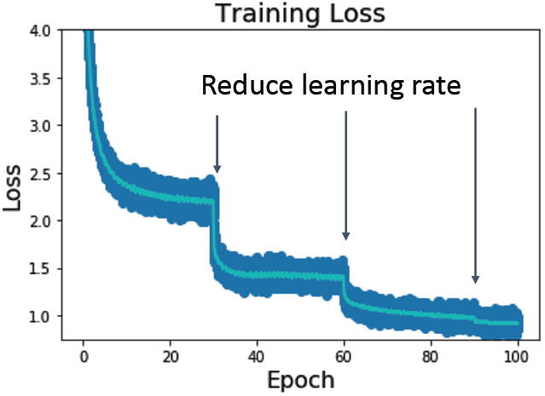
Learning Rate Schedule during Training

Slide 27
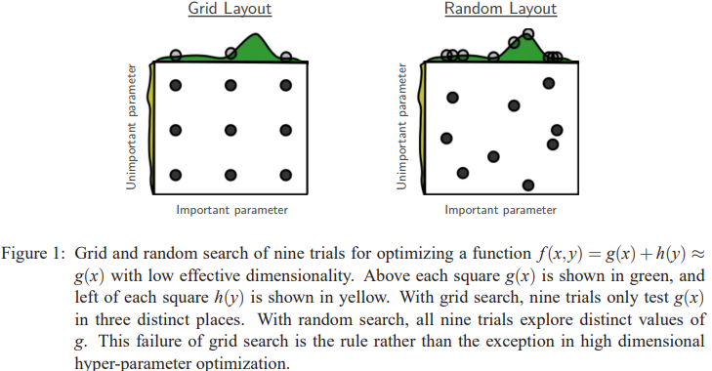
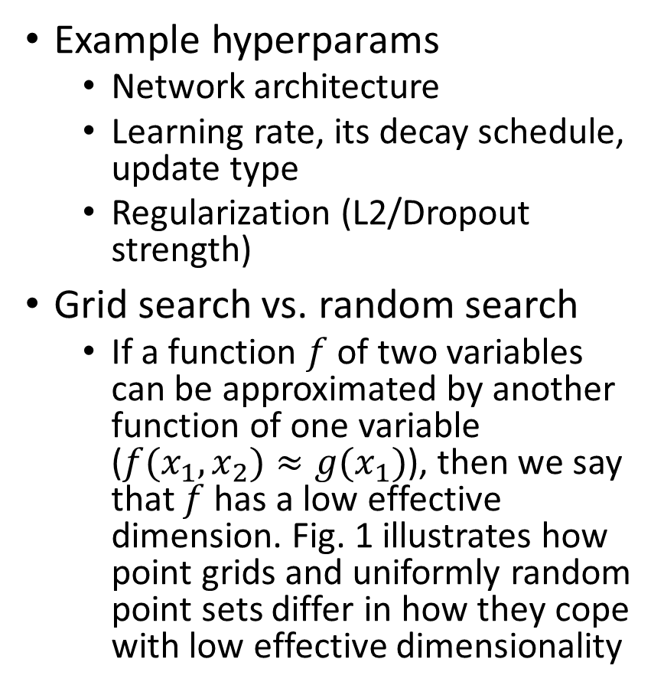
Hyperparameter Optimization
Example hyperparams
Network architecture
Learning rate, its decay schedule, update type
Regularization (L2/Dropout strength)
Grid search vs. random search
If a function $f$ of two variables can be approximated by another function of one variable ($f(x_{1}, x_{2})≈g(x_{1})$), then we say that $f$has a low effective dimension. Fig. 1 illustrates how point grids and uniformly random point sets differ in how they cope with low effective dimensionality
Bergstra, James, and Yoshua Bengio. "Random search for hyper-parameter optimization." Journal of machine learning research 13.2 (2012).

Slide 28
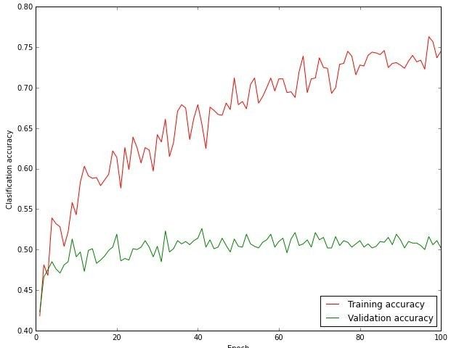
Classification Accuracy
Big gap between training accuracy and validation accuracy may imply overfitting => decrease model capacity/size
No gap may imply underfitting => increase model capacity/size

Slide 29
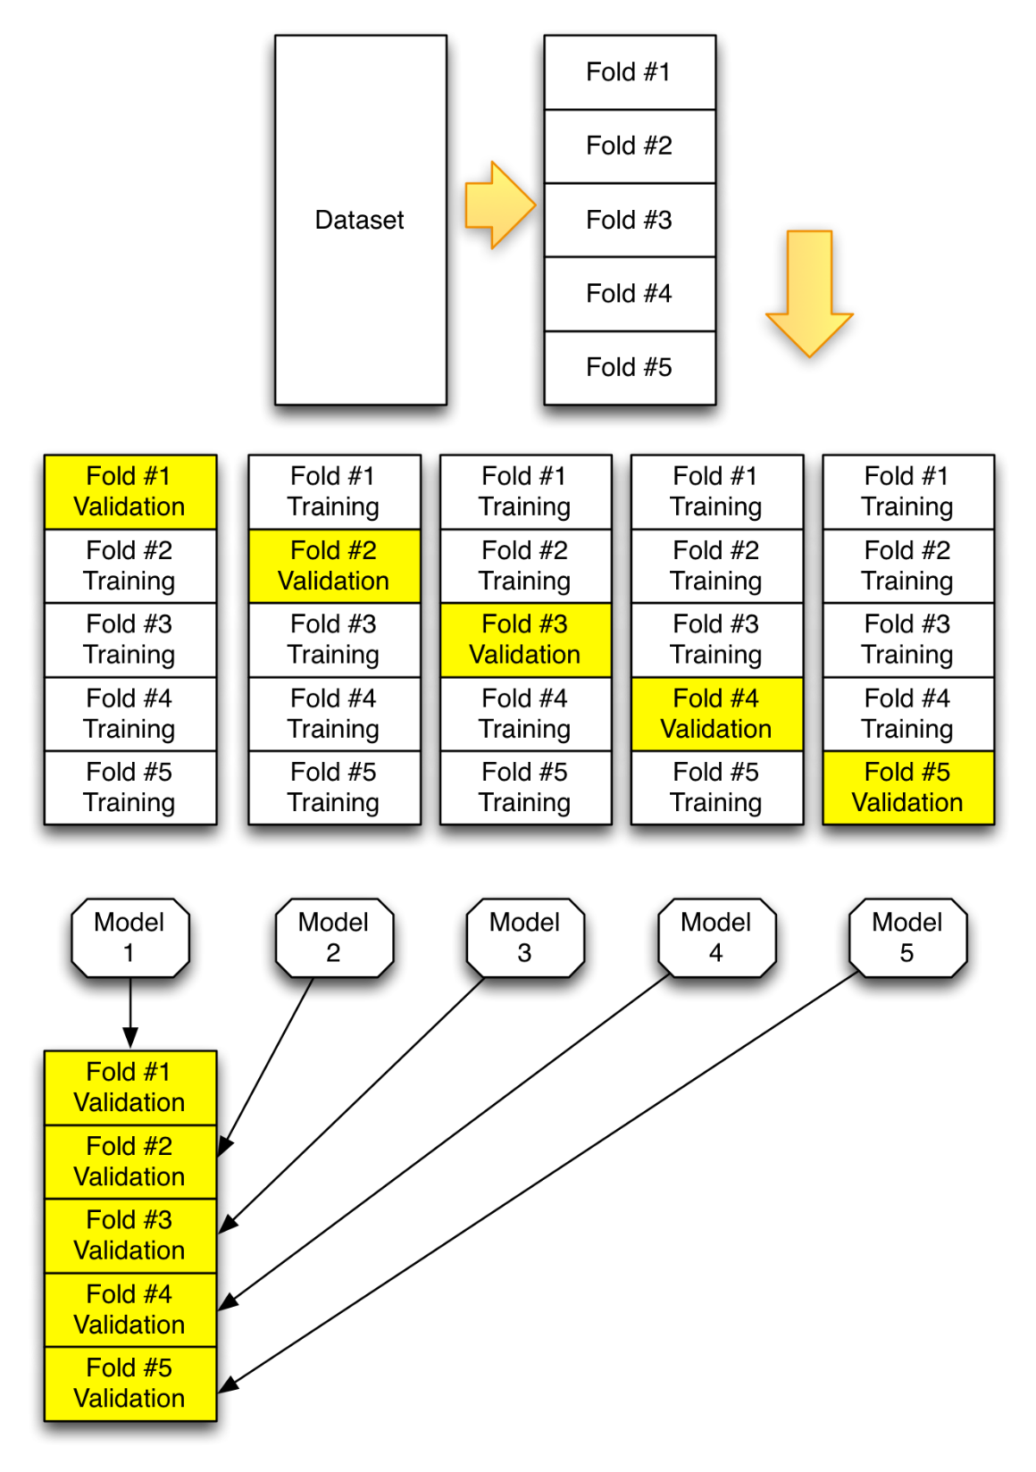

K-Fold Cross-Validation
Divide data into train data and test data. Since we cannot peek at the test data during training time, we use part of the train data for Cross-Validation
e.g., Divide training data into K=5 parts (folds). Use each fold as validation data, and the other 4 folds as training data. Cycle through the choice of which fold used for validation and average results
https://github.com/jeffheaton/t81_558_deep_learning/blob/master/t81_558_class_05_2_kfold.ipynb

Slide 30




Data Augmentation for Enlarging Training Dataset
Mirroring, random cropping, color shifting, rotation, shearing, local warping…
Color Shifting

